Slide 1
Rate of change from a coordinate pair
Graphical representations of linear equations

Slide 2
how to use Oak lessons

Slide 3
I can calculate the rate of change (gradient) from two coordinate pairs.

Slide 4
Two lines are parallel if they are straight lines that are always the same (non-zero) distance apart.
The gradient is a measure of how steep a line is. It is calculated by finding the rate of change in the y-direction with respect to the positive x-direction.

Slide 5

Rate of change from a coordinate pair
Reading the axes accurately to calculate gradient
Calculating gradient from coordinate pairs
Coordinates that lie on a straight line

Slide 6
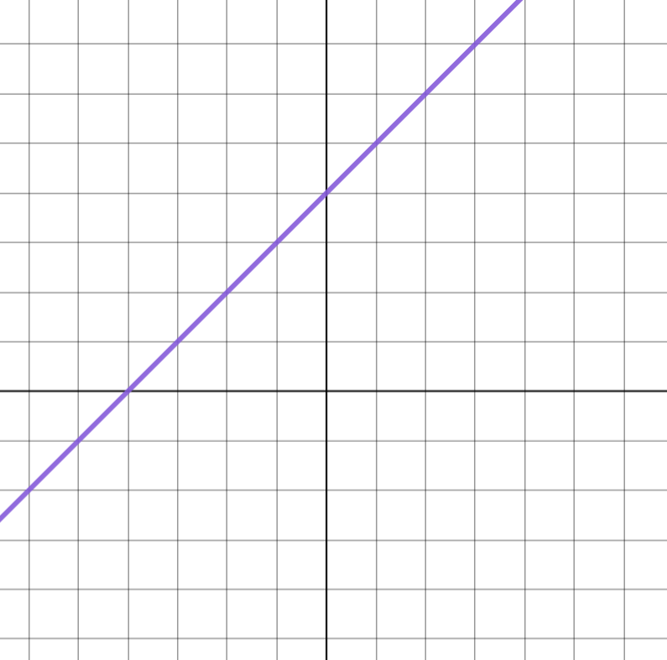
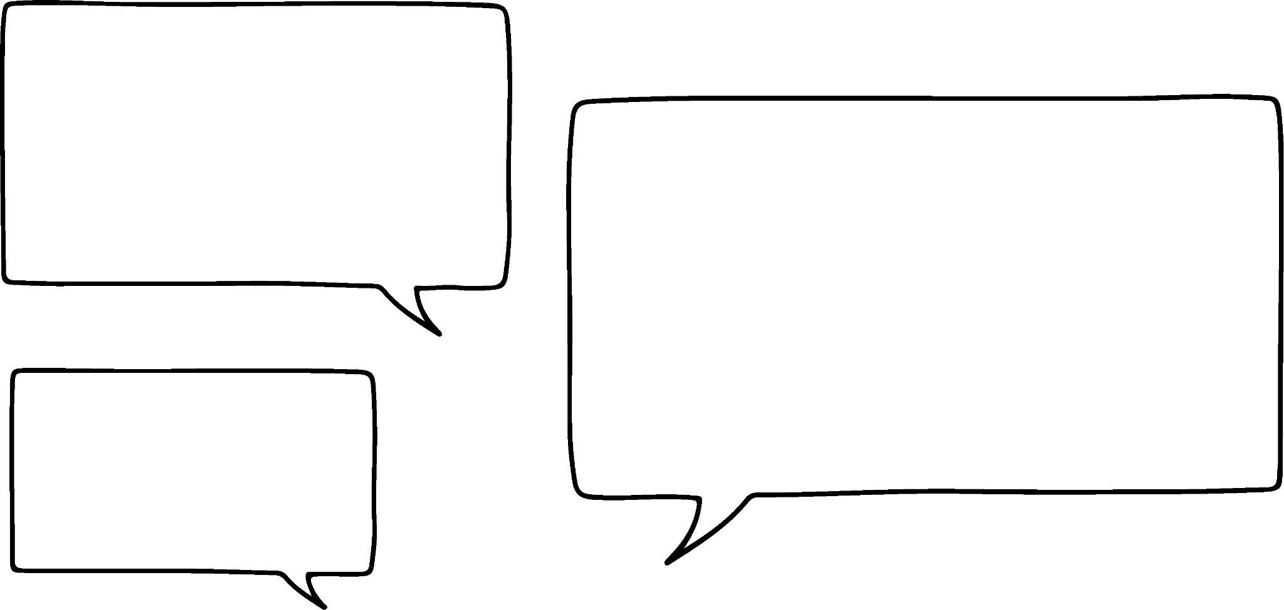


Reading the axes accurately to calculate gradient
We can calculate the gradient of a line if we know how much y changes when x increases by 1
The gradient could be
Sofia
What could the scales be on each axis for Sofia to be correct?

Slide 7
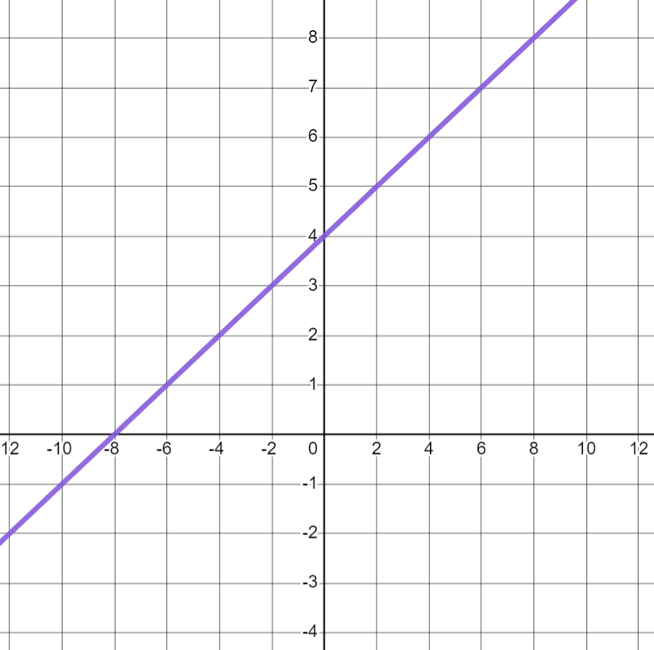
Reading the axes accurately to calculate gradient
The gradient could be
Sofia
Sofia would be correct if the scale on the y-axis was half the scale on the x-axis.
E.g x-axis has a step of 1 and y-axis has a step of 0.5
x-axis has a step of 2 and y-axis has a step of 1

Slide 8
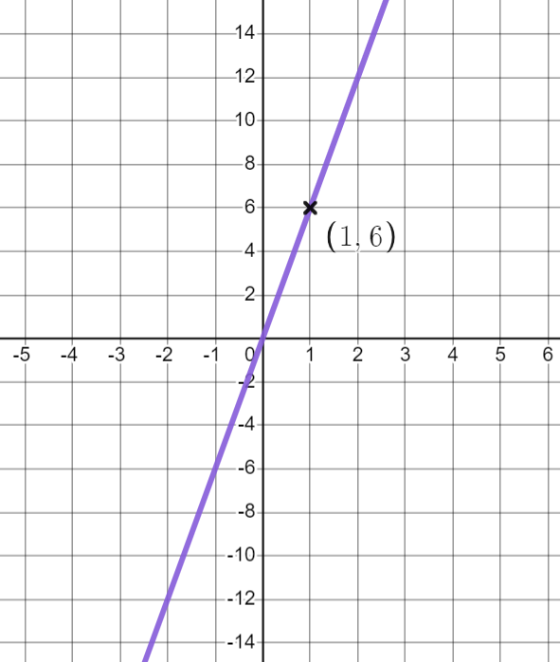
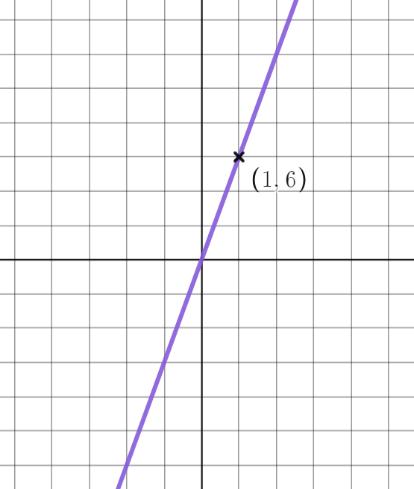
Reading the axes accurately to calculate gradient
If we know a coordinate on the line we can work out the scale.
Now we can calculate the gradient.
Change in x | Change in y
1 | 6
+6
So the gradient is 6
+1

Slide 9
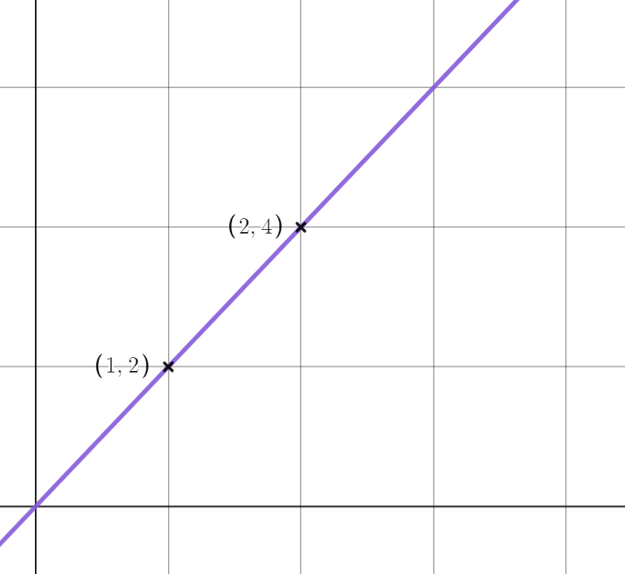
Reading the axes accurately to calculate gradient
Let’s calculate the gradient of this line.
Change in x | Change in y
1
2
So the gradient is 2
+2
+1

Slide 10
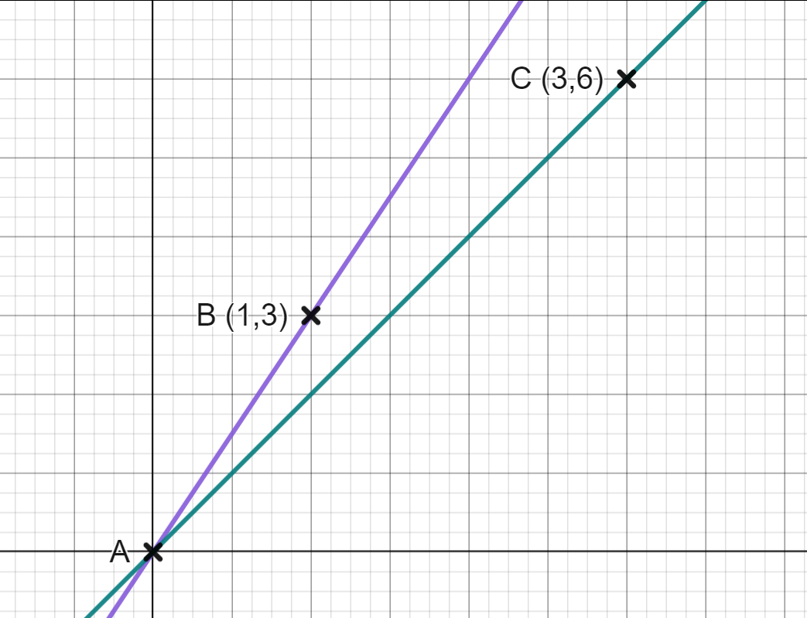
Reading the axes accurately to calculate gradient
A, B and C have been plotted on a set of axes. A is the origin.
a) What is the gradient of the purple line which passes through A and B?
b) What is the gradient of the green line which passes through A and C?
gradient = 3
+3
+1

Slide 11
Reading the axes accurately to calculate gradient
A, B and C have been plotted on a set of axes. A is the origin.
a) What is the gradient of the purple line which passes through A and B?
b) What is the gradient of the green line which passes through A and C?
gradient = 3
+6
Change in x | Change in y
3 | 6
1
+3
2
gradient = 2

Slide 12
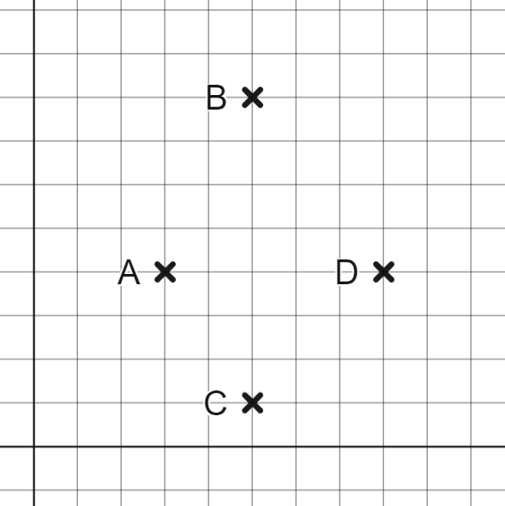
Reading the axes accurately to calculate gradient
The points A, B, C and D have been plotted on the same axes.
Which is steeper:
a) A to B or C to D?
b) A to C or B to D?
c) A to B or A to C?
d) Where could you move the coordinate, D, to make this shape a parallelogram?

Slide 13
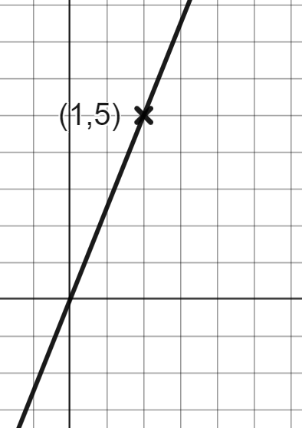
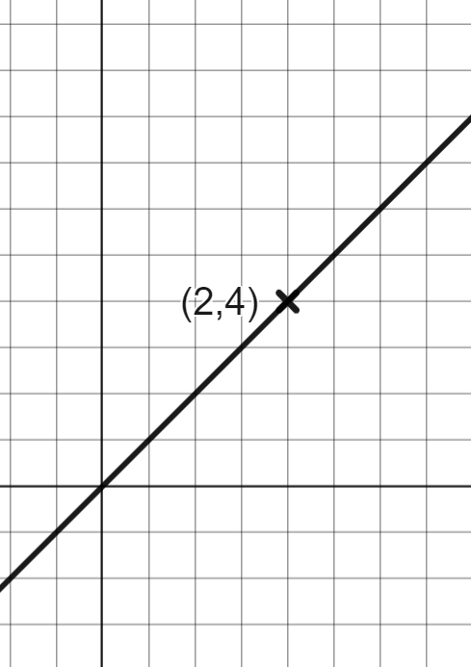
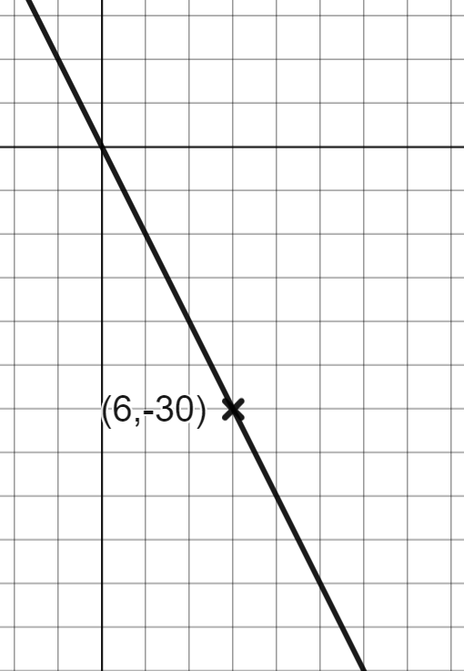
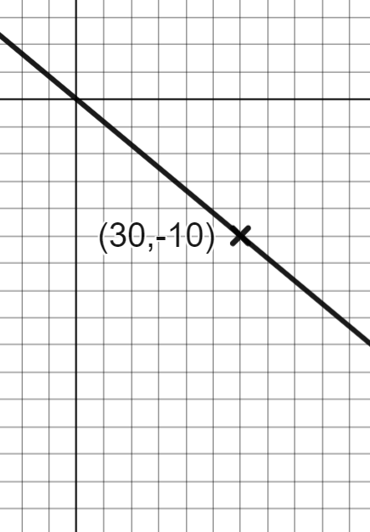
Reading the axes accurately to calculate gradient
2) Calculate the gradient of each line.
a) | b) | c) | d)

Slide 14
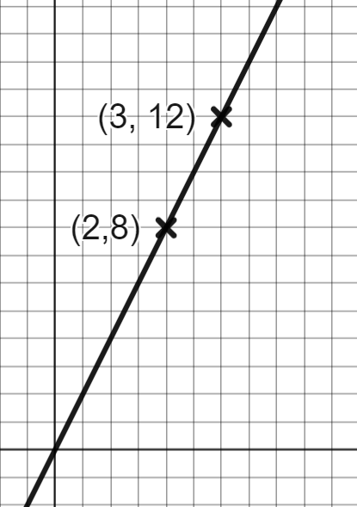
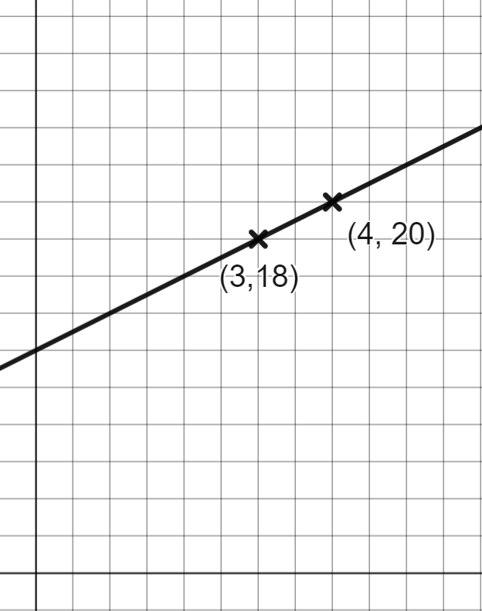
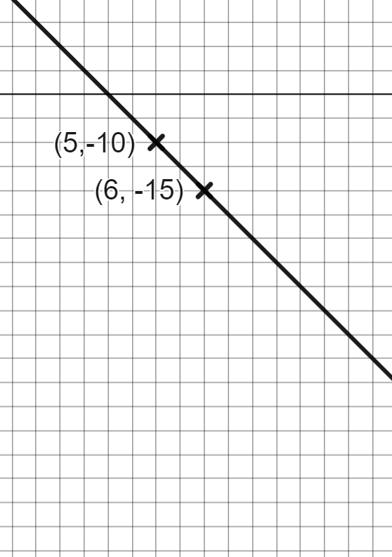
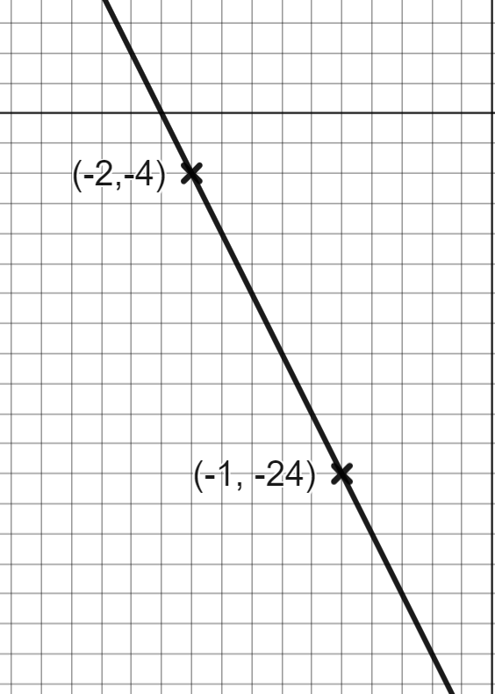
Reading the axes accurately to calculate gradient
2) Calculate the gradient of each line.
e) | f) | g) | h)

Slide 15
Reading the axes accurately to calculate gradient
The points A, B, C and D have been plotted on the same axes.
Which is steeper:
a) A to B or C to D?
b) A to C or B to D?
c) A to B or A to C?
A to B
D
×
A to C
A to B
d) Where could you move the coordinate, D, to make this shape a parallelogram?
One square left and one square up.

Slide 16

Reading the axes accurately to calculate gradient
2) Calculate the gradient of each line.
a) | b) | c) | d)
5
2
−5

Slide 17
Reading the axes accurately to calculate gradient
2) Calculate the gradient of each line.
e) | f) | g) | h)
4
2
−5
−20

Slide 18
Rate of change from a coordinate pair
Calculating gradient from coordinates using axes
Calculating gradient from coordinate pairs
Coordinates that lie on a straight line

Slide 19
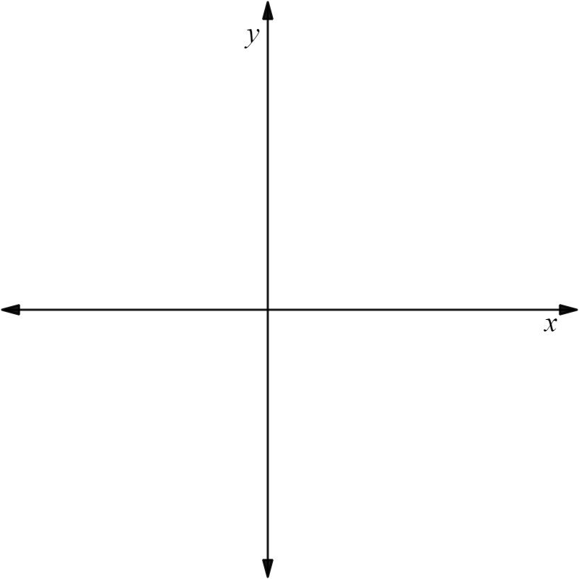
Calculating gradient from coordinate pairs
How could we see if Sofia is correct?
If I draw a line through the coordinates (3,4) and (6,1) the gradient of the line will be negative.
(3,4)
×
(6,1)
×
Sofia
We could sketch a set of axes and roughly plot where the points would be:
(6,1) is further right (in the positive x-direction) and further down than (3,4)
Sofia is correct, this line has a negative gradient.

Slide 20
Calculating gradient from coordinate pairs
If we draw a line through the coordinates (−5,4) and (−8,−2) will the gradient be positive or negative?
(−5,4)
×
×
(−8,−2)
(−8,−2) is further left (negative x-direction) and further down than (−5,4)
This time the gradient is positive.

Slide 21
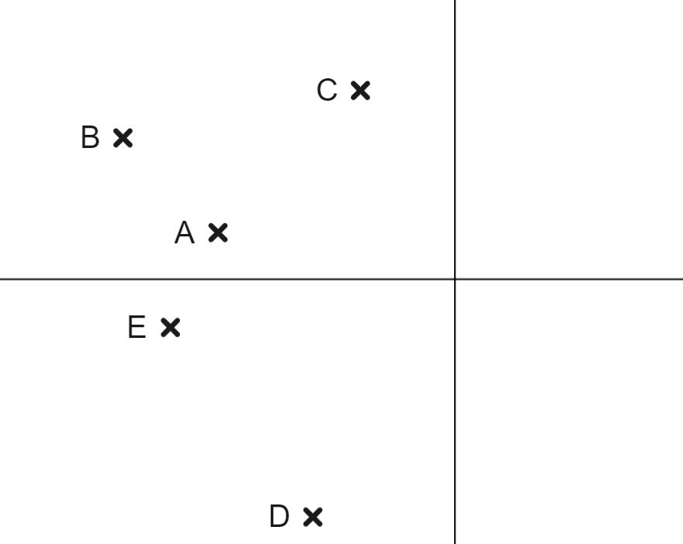
Calculating gradient from coordinate pairs
Sofia has plotted the coordinates (−7,3) (−3,−5) (−5,1) (−6,−1) and (−2,4) Which coordinate is which letter on the graph?
A (−5,1)
B (−7,3)
C (−2,4)
D (−3,−5) E (−6,−1))
She draws a line through two of the coordinates and the gradient is negative. Which two could it have been?
A and D
B and A, B and D, B and E
D and E

Slide 22

Calculating gradient from coordinate pairs
The gradient of the line which goes through (−4,5) and (−7,9) is 1.3
Let’s look at Lucas’ working to see if he is correct.
Where has he gone wrong?
Lucas
(−7,9)
×
+4
He has plotted his coordinates wrong.
(−4,5)
×
+3
Change in x | Change in y
3 | 4
1
1.3

Slide 23


Calculating gradient from coordinate pairs
The gradient of the line which goes through (−4,5) and (−7,9) is 1.3
Let’s look at Lucas’ working to see if he is correct.
+3
Where has he gone wrong?
Lucas
×
−4
(−7,9)
He has plotted his coordinates wrong.
×
(−4,5)
His line will have a negative gradient.
−4 ÷ 3 is not exactly −1.3
He should leave his answer as a fraction.
Change in x | Change in y
3
−4
The gradient is
4
÷3
÷3
1
1.3

Slide 24

Calculating gradient from coordinate pairs
The gradient of a line can be calculated without sketching the points.
Work out the gradient of the line joining the coordinates (3, −2) and (−7, 3)
Because gradient is the change in y when x increases by 1, it is useful to rewrite these so the coordinate with the smallest x-value is first.
+10
−5
Change in x | Change in y
(−7, 3) and (3, −2)
10
−5
1
÷10
3−(−7) = 10
−2−3 = −5
It is still recommended to sketch the points to make sure the gradient is negative as expected.

Slide 25
Calculating gradient from coordinate pairs
Calculate the gradient of the line through (−10,−9) and (−6, 7)
Calculate the gradient of the line through (2,−5) and (−8, 5)
(−6,7)
gradient is positive
(−8,5)
+10
gradient is negative
×
×
−10
+16
gradient = 4
×
gradient = −1
(−10,−9)
×
(2,−5)
+4
Change in x | Change in y
4 | 16
Change in x | Change in y
10 | −10
÷4
÷10
1
4
1
−1

Slide 26
Calculating gradient from coordinate pairs
Find the gradient of the line joining the two coordinates given. You may use the axes to help.
a) (7,8) and (4,2) | b) (−1,8) and (1,2) | c) (−1,−2) and (1,10) | d) (3,−2) and (−5,10)

Slide 27
Calculating gradient from coordinate pairs
2) In each question, decide which line will be steeper.
a) The line joining (0,0) and (5,7) or the line joining (0,0) and (5,−4)
b) The line joining (0,0) and (3,4) or the line joining (0,0) and (6,7)
c) The line joining (1,2) and (2,5) or the line joining (5,1) and (6,5)
d) The line joining (−4,4 ) and (5,−4 ) or the line joining (2,−1) and (11, −8)

Slide 28

Calculating gradient from coordinate pairs
Find the gradient of the line joining the two coordinates given. You may use the axes to help.
a) (7,8) and (4,2) | b) (−1,8) and (1,2) | c) (−1,−2) and (1,10) | d) (3,−2) and (−5,10)
×
+8
×
×
×
+2
+6
−6
−12
+12
×
×
+3
×
×
+2
3 | 6
1 | 2
2 | −6
1 | −3
2 | 12
1 | 6
8 | −12
1
gradient = 2
gradient = −3
gradient = 6

Slide 29
Calculating gradient from coordinate pairs
2) In each question, decide which line will be steeper.
a) The line joining (0,0) and (5,7) or the line joining (0,0) and (5,−4)
b) The line joining (0,0) and (3,4) or the line joining (0,0) and (6,7)
c) The line joining (1,2) and (2,5) or the line joining (5,1) and (6,5)
d) The line joining (−4,4 ) and (5,−4 ) or the line joining (2,−1) and (11, −8)
Larger change in y for the same change in x.
For the same gradient the second coordinate would need to be (6,8).
Larger change in y for the same change in x.
Larger change in y for the same change in x.

Slide 30
Rate of change from a coordinate pair
Calculating gradient from coordinates using axes
Calculating gradient from coordinate pairs
Coordinates that lie on a straight line

Slide 31
Coordinates that lie on a straight line
We can see whether three coordinates are on the same line by checking the gradient between them.
Are (1,1), (2,4) and (5,13) on the same line?
+1
+3
Start by finding the gradient between the first two points.
(1, 1) and (2, 4)
2 − 1 = 1
4 − 1 = 3
Change in x | Change in y
1 | 3
gradient = 3

Slide 32
Coordinates that lie on a straight line
We can see whether three coordinates are on the same line by checking the gradient between them.
Are (1,1), (2,4) and (5,13) on the same line?
+3
+9
Then check the gradient between the second two points.
(2, 4) and (5, 13)
5 − 2 = 3
13 − 4 = 9
The gradient is the same so they must be on the same straight line.
Change in x | Change in y
3 | 9
gradient = 3
1
3

Slide 33
Coordinates that lie on a straight line
So (1,1), (2,4) and (5,13) are on the same line.
Remember: points that lie on a straight line will follow the same linear relationship.
These are not always easy to spot.
For these coordinates the rule is: y = 3x − 2

Slide 34

Coordinates that lie on a straight line
You can pick any two points on a line to calculate the gradient of the line.
The gradient is the same everywhere on the line.
Any two coordinates on a line will be the same distance apart.

Slide 35
Coordinates that lie on a straight line
For which options can we be sure the coordinate lie on the same line?
The line between A and B has the same gradient as the line between B and C
The line between A and B has the same gradient as the line between C and D
The line between B and C has the same gradient as the line between A and C

Slide 36
Coordinates that lie on a straight line
By testing the gradient. See whether each set of three points lie on a straight line.
(1,2), (2,6) and (4,12)
(2,−8), (6,−4) and (13,3)
(0,9), (2,5) and (5,−1)
(−5, 0), (−3,−4) and (3,−8)

Slide 37
Coordinates that lie on a straight line
By testing the gradient. See whether each set of three points lie on a straight line.
(1,2), (2,6) and (4,12)
(2,−8), (6,−4) and (13,3)
(0,9), (2,5) and (5,−1)
(−5, 0), (−3,−4) and (3,−8)
No, the gradient between (1,2) and (2,6) is 4 but the gradient between (2,6) and (4,12) is 3
Yes, the gradient between any 2 points is 1
Yes, the gradient between any 2 points is −2
No, the gradient between (−5, 0) and (−3,−4) is −2 but the gradient between (−5, 0) and (3, −8) is −1

Slide 38
Rate of change from a coordinate pair
The gradient of a line can be calculated given two coordinates on that line.
Sketching the coordinates can help determine if the gradient is positive or negative.
The gradient can be calculated without drawing the points however a sketch can help avoid mistakes.
Three points A, B and C will be on the same straight line if the gradient between A and B is the same as B and C.

Slide 39

© Oak National Academy 2023.
Produced in partnership with Mathematics in Education and Industry.
Licensed on the Open Government Licence v3.0, except where otherwise stated. See Oak terms and conditions.

